Slide 1
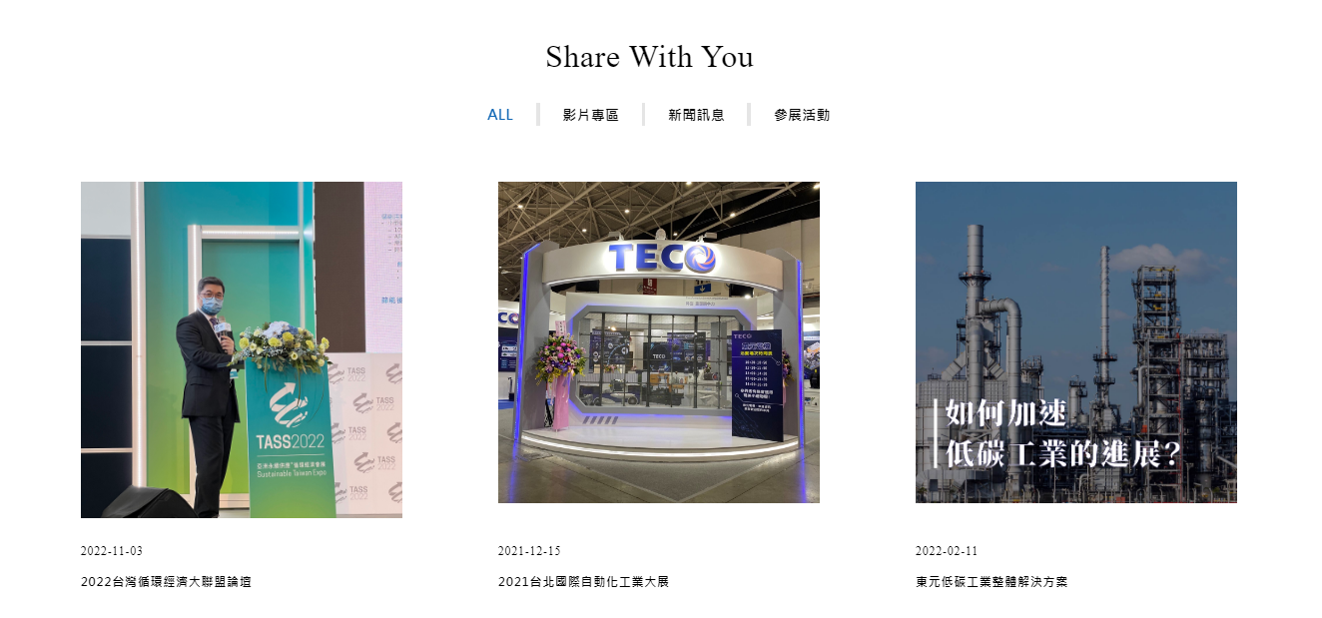
要有文章與影音的上架日期，上架日期為檔名前面的數字
影片有封面圖

Slide 2
標題:
創意電子影片_ESG篇
GUC ESG
日期:
2024/6/25
網址:
https://youtu.be/r2nJQKsap0s?si=LgYwxfoObVrL2hur
嵌入碼:
<iframe width="560" height="315" src="https://www.youtube.com/embed/r2nJQKsap0s?si=uZXJkiLnsYS2YiNA" title="YouTube video player" frameborder="0" allow="accelerometer; autoplay; clipboard-write; encrypted-media; gyroscope; picture-in-picture; web-share" referrerpolicy="strict-origin-when-cross-origin" allowfullscreen></iframe>

Slide 3
標題:
創意電子志工社_安德烈食物銀行志工服務篇
GUC Volunteer Club: Food Bank Volunteer Service
日期:
2024/8/27
網址:
https://www.youtube.com/watch?v=L6tceLLZmE4&t=6s
嵌入碼:
<iframe width="560" height="315" src="https://www.youtube.com/embed/L6tceLLZmE4?si=3czFVpWmy8eiVD4j" title="YouTube video player" frameborder="0" allow="accelerometer; autoplay; clipboard-write; encrypted-media; gyroscope; picture-in-picture; web-share" referrerpolicy="strict-origin-when-cross-origin" allowfullscreen></iframe>

Slide 4
標題:
創意電子獲頒 2024亞洲最佳雇主獎_總經理受訪片段
GUC wins " The Best Company to Work for in Asia Awards2024 "
日期:
2024/10/17
網址:
https://www.youtube.com/watch?v=k1xJOIQkRF0
嵌入碼:
<iframe width="560" height="315" src="https://www.youtube.com/embed/k1xJOIQkRF0?si=f0qOz8-8Vg513ifp" title="YouTube video player" frameborder="0" allow="accelerometer; autoplay; clipboard-write; encrypted-media; gyroscope; picture-in-picture; web-share" referrerpolicy="strict-origin-when-cross-origin" allowfullscreen></iframe>

